Slide 1

Web Service Development
LAMP

Slide 2
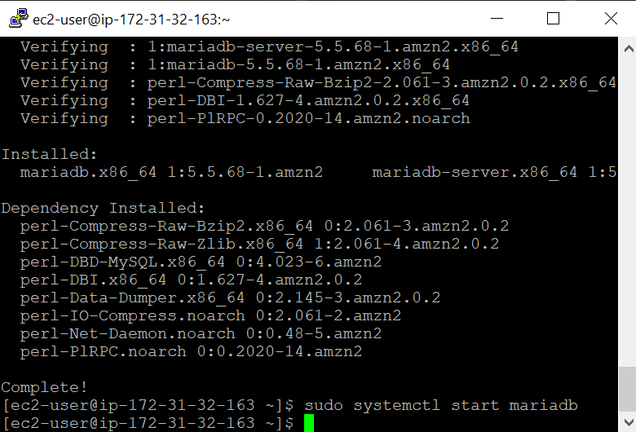
HTTPd, Wordpress, and MariaDB Installation
The installation of MariaDB server and client
Apache web server installation
WordPress Download using wget command , and installation.

Slide 3
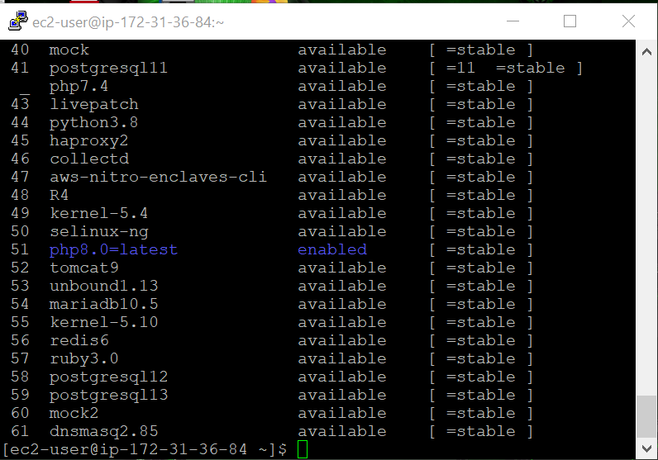
PHP
The latest php version PHP 8.0 was installed and enabled on the webserver .

Slide 4
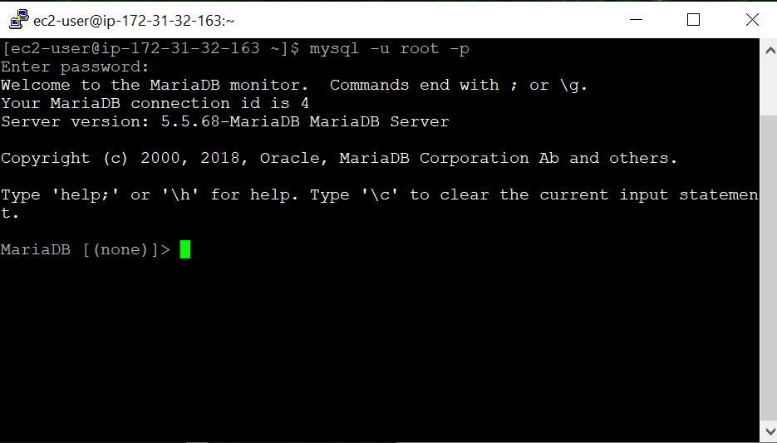
Database Server root access
Logged into MariaDB server as a root user

Slide 5
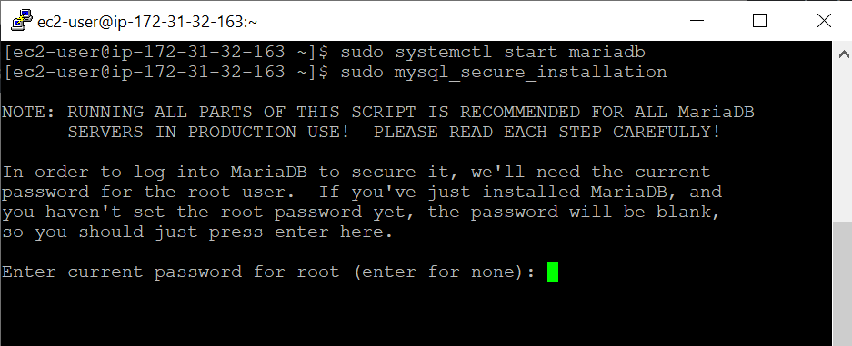
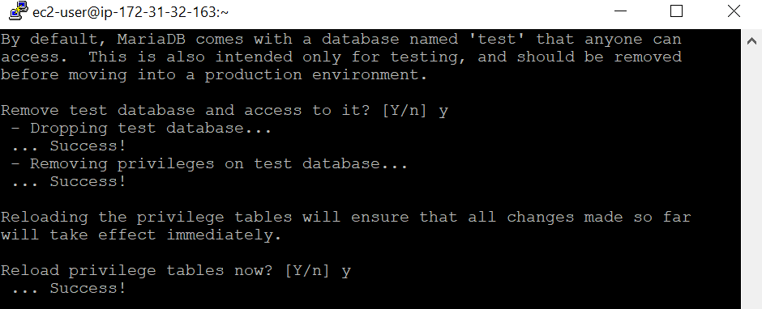
Securing MariaDB
The command: sudo mysql_secure_installation ; will start the steps for securing the database server.
Test database is removed while configuring .
Privileges on test database is removed
Privilege tables are reloaded to ensure all changes apply.

Slide 6
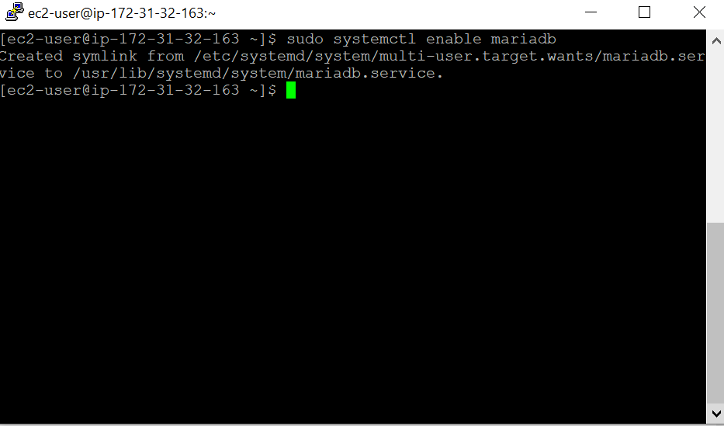
Ensuring the Database Server starts at Boot time.
The following command enables MariaDB to start at boot time

Slide 7
Ensuring Webserver starts at boot time
The following command is used to start Apache at boot time; sudo systemctl enable httpd

Slide 8
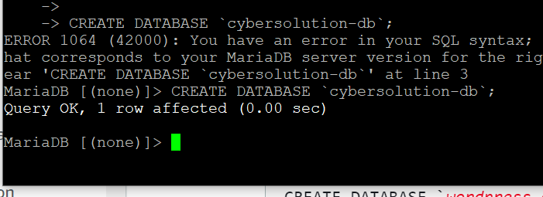
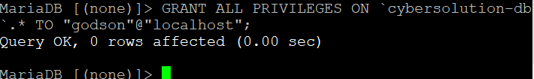

Database Creation
User and password is created for the MariaDB database.
Database name is created using the query CREATE DATABSE
Full privileges are granted to the Wordpress user using the GRANT ALL PRIVILEGES ON query .
Finally, the database privileges are flushed using the FLUSH PRIVILEGES; query . As a result, all changes made to the database applies.

Slide 9
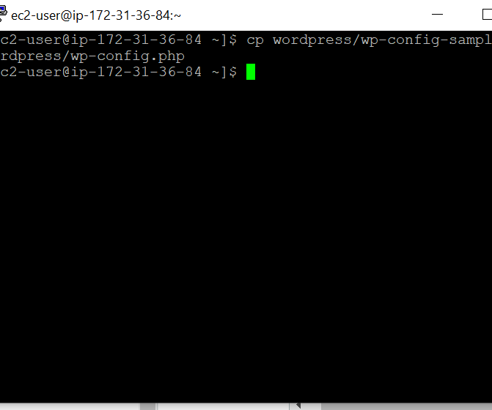
Editing the WordPress Configuration File
The sample config file is copied into the WordPress config file.

Slide 10
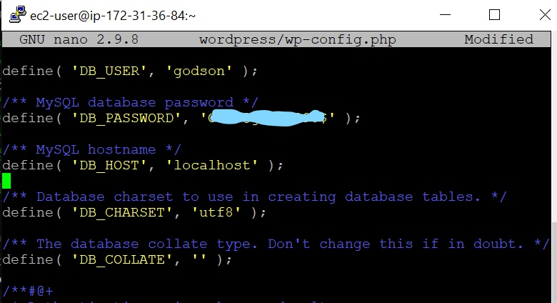
Editing Config File

Slide 11
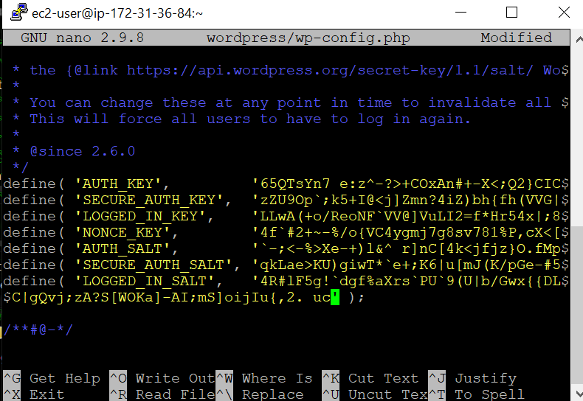
Editing Config File

Slide 12
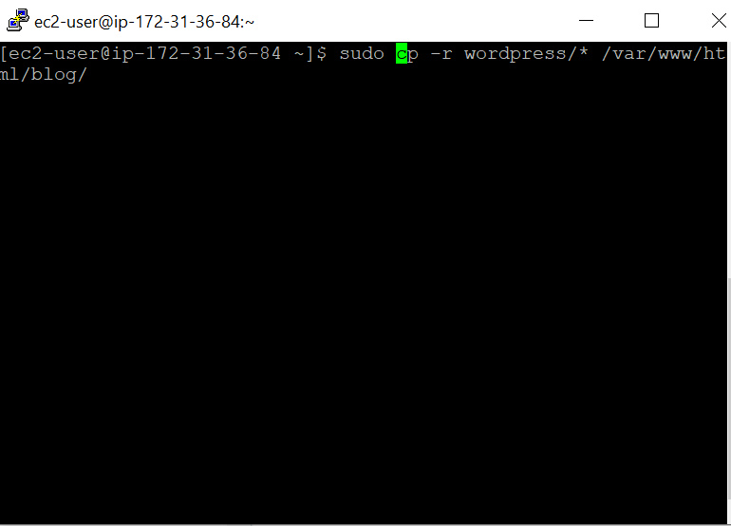
Running WordPress on the blog directory
The cp command is used to copy the WordPress directory into the blog directory

Slide 13
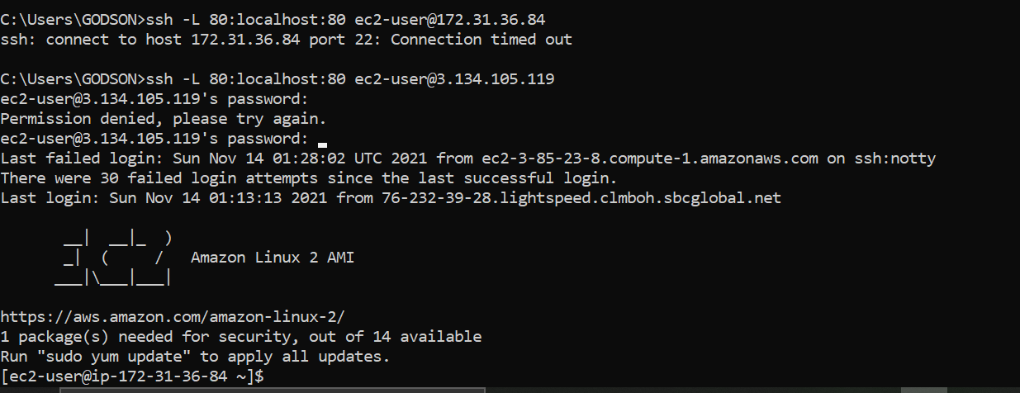
SSH Port Forwarding

Slide 14
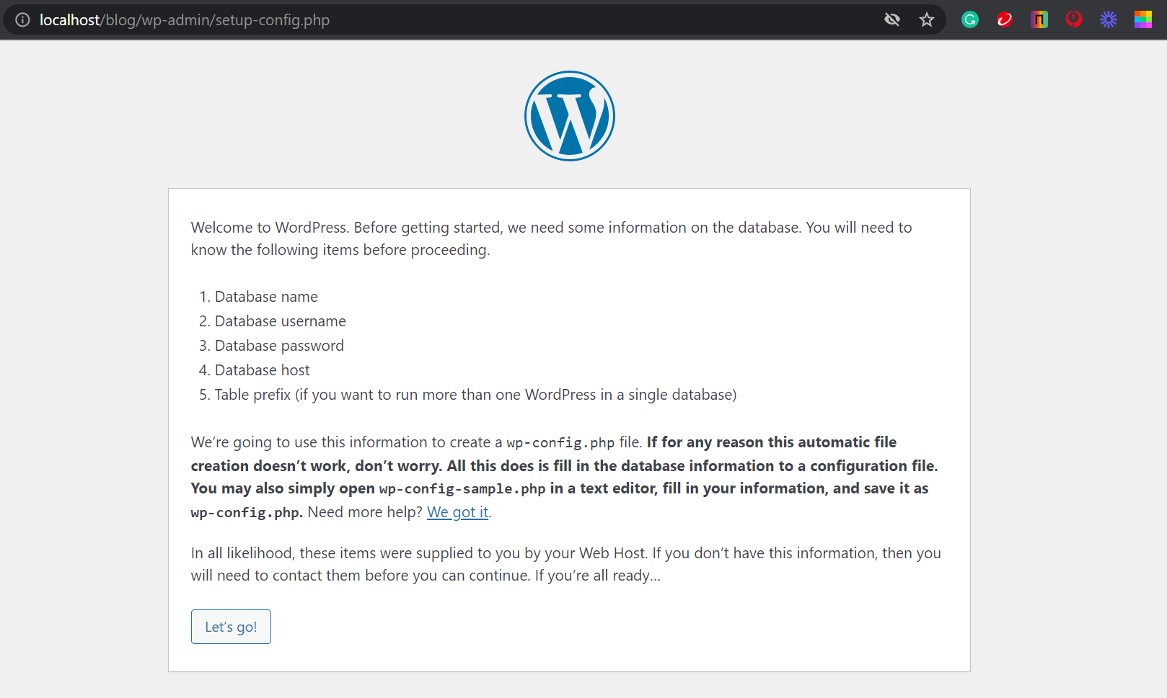
WordPress Admin Page

